Slide 1

General Meeting
10h - 12h
20 May 2014
ASBL: 874.358.592 | Square du Vieux Tilleul 1/4, 1050 Ixelles, Belgium

Slide 2
Agenda
Welcome by Jimmie Bradshaw
Guest Speaker – Major General Mojsilovic
Welcomes and Farewells by Jimmie Bradshaw
  VOTE: Approval of Minutes from 6 April 2014
Vice-President & Guest Access by Beckie Metelko
Treasurer Update by Alessandra Foresti
Membership by Trine Lauvsnes
Sponsorship, Events, & Bake Sale Update by Dionysia Leolei
Coffee Break (15 minutes)
Bazaar Update by Emily Michnay
Charity Update by Sabrina Janssens & Julija Vejic
Tombola Update by Carla Bucalossi Quatrini
Restaurant Update by Christina Arvanitaki
Any other Business and Closing by Jimmie Bradshaw

Slide 3
Major General Mojsilovic
Serbian Military Representative
Biljana Marilovic
NCB Assistant Treasurer & Consular in BiH Mission to NATO

Slide 4
Welcome to Members
Jimmie Bradshaw - President
Alice Luukas, NR Estonia
Eva Haga Rogneflåten, ANR Norway
Kamila Kocianová, NR Slovakia
Silvia Klestincová, 3rd ANR Slovakia
Mia Werin, NR Sweden
Tiffany Boatwright, ANR United Kingdom
Welcome on Board ☺

Slide 5

Farewell to Members
Jimmie Bradshaw - President
Annemarie Kunzer, ANR Austria
Blanka Oujezdska, 2nd ANR Czech Republic
Elis Korvek, NR Estonia
Anniken Lunder, 2nd ANR Norway
Nathalie Wohlhauser, NR Switzerland
Emine Ozgur, ANR, Turkey
Emma Notman, ANR United Kingdom
Wishing you all the best

Slide 6
Farewell to Board Members
Jimmie Bradshaw - President
Biljana Marilovic
  Assistant Treasurer
Linda Skou
  Secretary/Assistant Secretary
Wishing you all the best

Slide 7
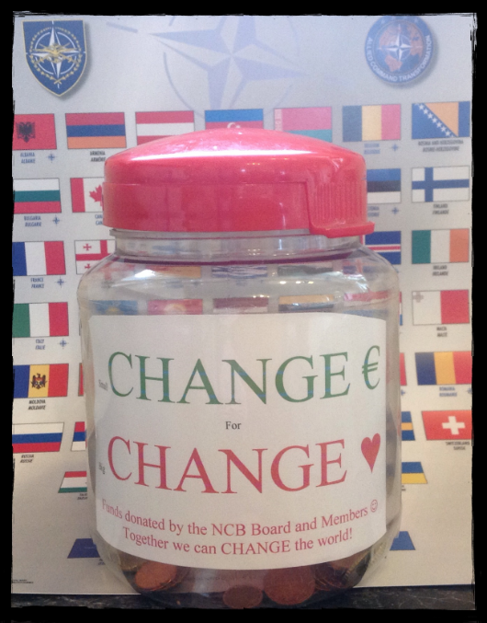
Vice-President/Guest Access
Beckie Metelko – Vice President & Guest Access
Small Change for Big Change
Guest Access will be more limited than last year
Sign up to meet with Jimmie Bradshaw

Slide 8

Treasurer Update
Alessandra Foresti Bertozzi - Treasurer
CONTRIBUTION 2014
New
Shen Yun tickets sale
2.373 EUROS
On 18 May 2014
Hulencourt Concert ?

Slide 9
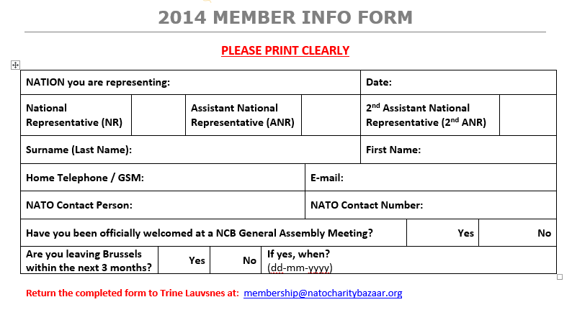
Membership Database
Trine Lauvsnes– Membership Coordinator

Slide 10


Sponsors for 2014
Dionysia Leolei, Sponsorship

Slide 11

Sponsors & Events
Dionysia Leolei, Sponsorship & Events, Bake Sales
5th of June Behind the Silk Curtain Book presentation
12th of June Bake Sale
24th – 26th of June Photo Exhibition

Slide 12
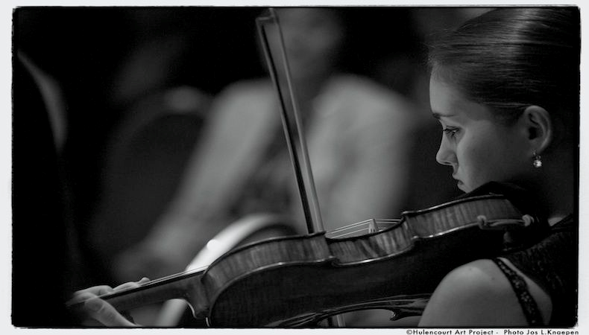

Hulencourt Art Project
Dionysia Leolei, Sponsorship & Events, Bake Sales
Total amount collected:…€

Slide 13

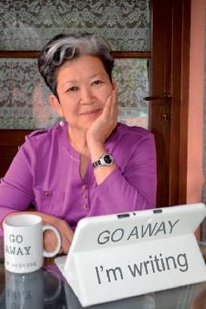
Book presentation and Charity Sale
Dionysia Leolei, Sponsorship & Events, Bake Sales
5th of June 2014 10:30
Book presentation
Charity Sale
Traditional food from Kazakhstan

Slide 14




Bake Sale
Dionysia Leolei, Sponsorship & Events, Bake Sales

Slide 15
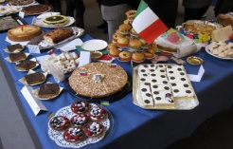
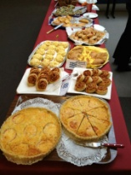
BAKE SALE REMINDERS
Dionysia Leolei, Sponsorship & Events, Bake Sales
WHAT TO BRING
Baked Good(s) Sweet or Savory

Slide 16
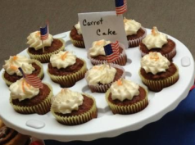
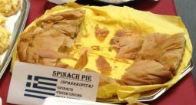
BAKE SALE REMINDERS
Dionysia Leolei, Sponsorship & Events, Bake Sales
A SHORT DESCRIPTION
(i.e. Apple Crumb Cake with Walnuts, Spinach and Cheese Pie)

Slide 17
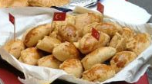
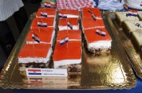
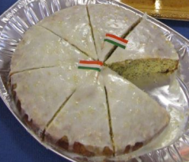
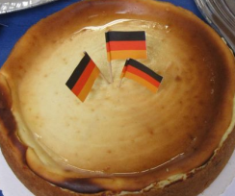
BAKE SALE REMINDERS
Dionysia Leolei, Sponsorship & Events, Bake Sales
SMALL COUNTRY FLAGS

Slide 18
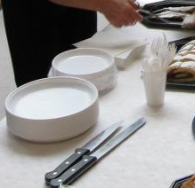
BAKE SALE REMINDERS
Dionysia Leolei, Sponsorship & Events, Bake Sales
Paper plates
Napkins
Plastic spoons or forks
Cutting/serving utensils
Small or medium, sturdy, (labeled with your name, country and phone number)

Slide 19

BAKE SALE REMINDERS
Dionysia Leolei, Sponsorship & Events, Bake Sales
DELIVER NO LATER THAN 08:30
IN THE PRESS HALL IN FRONT OF LUNS THEATRE (ING BANK)

Slide 20

BAKE SALE REMINDERS
Dionysia Leolei, Sponsorship & Events, Bake Sales
PICK UP NO LATER THAN 13:30 (1:30 pm)
IN THE PRESS HALL IN FRONT OF LUNS THEATRE (ING BANK)

Slide 21
BAKE SALE REMINDERS
Dionysia Leolei, Sponsorship & Events, Bake Sales
REMEMBER !
LABEL ALL SERVING DISHES/UTENSILS WITH
NAME, PHONE NUMBER, NATION

Slide 22

Photo exhibition and Charity Sale
Dionysia Leolei, Sponsorship & Events, Bake Sales
Photo exhibition by…….
24-26th of June 2014
Opening 24th of June 11:00

Slide 23
Please turn in your charity lottery slips to Sabrina ASAP!

Slide 24

Photo Session
The Big Smile Time

Slide 25

Coffee Break
15 min
Thank you Portugal
for providing snacks this morning!

Slide 26

Bazaar First Steps
Emily Michnay - Bazaar Coordinator
Bazaar 2014 | Preliminary Instructions
Organizing your National Team
Finding sponsors
  Sponsor letters
  Tri-fold
Planning your stand
« Members Only » Section of Web Site

Slide 27

Bazaar First Steps
Emily Michnay - Bazaar Coordinator

Slide 28

Participation Questionnaire Needed from
the Following Nations
Albania
Artist Corner
Austria
Azerbaijan
Bosnia and Herzegovina
Bulgaria
Canada
Czech Republic
Estonia
France
Georgia
Germany
Iceland
Latvia
Luxembourg
Montenegro
Norway
Poland
Serbia
Spain
Sweden
Tajikistan
the former Yugoslav
Republic of Macedonia*
Ukraine
United Kingdom
United States
Final Due Date
17June
Questionnaires Received: 17
*Turkey recognizes the Republic of Macedonia with its constitutional name.

Slide 29
Participation Questionnaire
Emily Michnay- Bazaar Coordinator
Participation Options
  National Stand
  Restaurant Stand
  Tombola
New Location
Kitchen Space

Slide 30
Bazaar First Steps
Emily Michnay- Bazaar Coordinator
Bazaar 2014 | Participation Questionnaire
1. My country wishes to participate in the 2014 NATO Charity Bazaar as follows:
a. National Stand Yes/No
b. International Restaurant Stand Yes/No
c. International Tombola Yes/No
2. If you cannot commit to your country’s participation in one of the above at this time, when might we receive final commitment?
Date: ?
3. My country wishes to ONLY participate in the International Tombola (no national stand / no stand in the International Restaurant) Yes
Please return this questionnaire at the 20 May or 17 June General Meetings, or e-mail it to coordinator@natocharitybazaar.org

Slide 31
Bazaar First Steps
Emily Michnay- Bazaar Coordinator
Bazaar 2014 | Participation Questionnaire
4. My country is interested in a different stand location at the bazaar
5. My country is interested in kitchen space Yes/No
Please return this questionnaire at the 20 May or 17 June General Meetings, or e-mail it to coordinator@natocharitybazaar.org

Slide 32
Stage Manager
Emily Michnay - Bazaar Coordinator
Bazaar 2014 | Entertainment
Stage Manager:
Stage Manager Needed!
Please see Jimmie Bradshaw if you or someone you know is interested!

Slide 33
Bazaar First Steps
Emily Michnay - Bazaar Coordinator
Bazaar 2014 | Preliminary Instructions
Entertainment
  We are looking for music or dance groups from your country to perform at the bazaar.
  coordinator@natocharitybazaar.org
  Subject: Entertainment
Stage Manager: Stage Manager Needed!

Slide 34
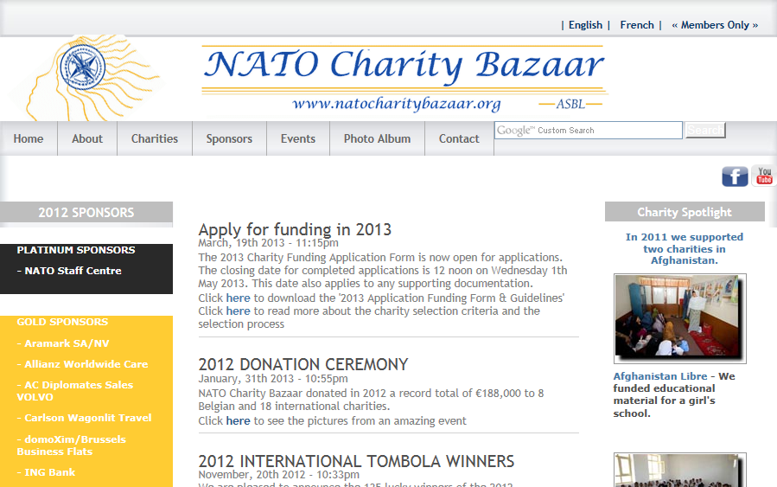
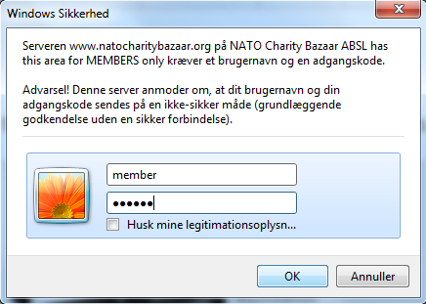
Web Site Reminder
www.natocharitybazaar.org
User Name: member
Password: member
User Name: members
Password: members
User Name: membre
Password: membre

Slide 35
Charity Update
Sabrina Janssens & Julija Vejic
Charity Coordinators
  Status on received Charity Applications
  Explanation of Belgian Charity visits
  Charity Visits Lottery - Result
  Charity Selection Vote – September 9th meeting

Slide 36
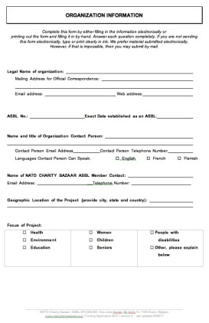
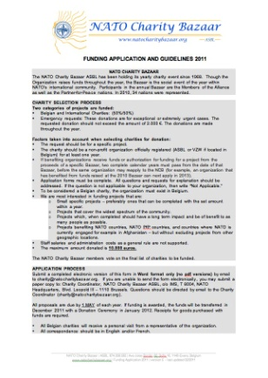
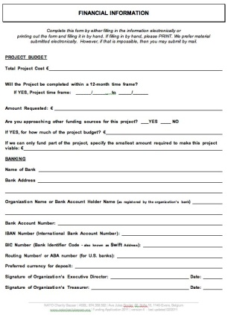
Charity Funding Applications
Belgian Charities
10 Eligible Applications
International Charities
68 Received Applications
31 Applications rejected (three applications per country rule)
37 Applications in review

Slide 37
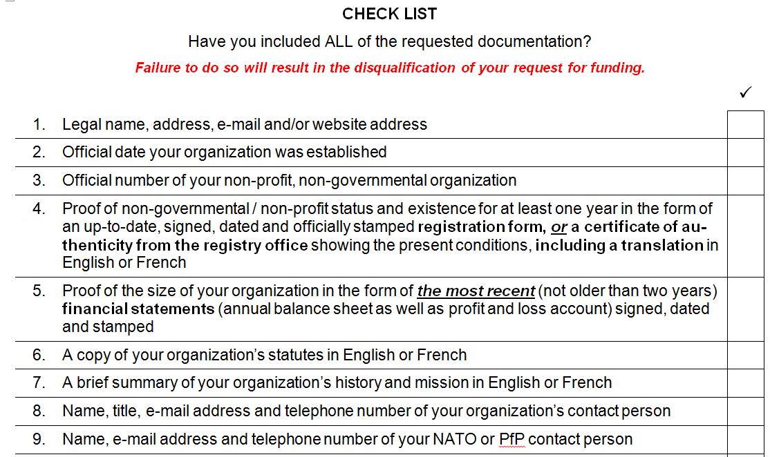
Charity Funding Applications
Julija Vejic – International Charity Coordinator

Slide 38
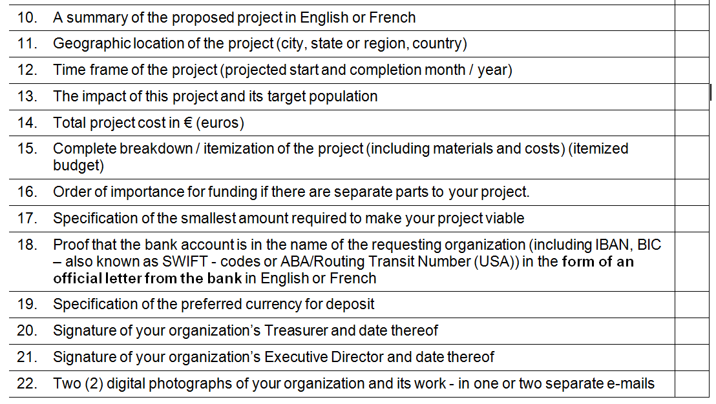
Charity Funding Applications
Julija Vejic – International Charity Coordinator

Slide 39
Charity Visits
Sabrina Janssens
TO DO
  Organize Visits
  During and after visits fill in "2014 Belgian Charity Visit Form”
  Send electronically to Sabrina Janssens at char@natocharitybazaar.org
  Final Due – June 30

Slide 40
Charity Visits Agenda
Sabrina Janssens
Charity | Nations | Visit date
Project 1 | Finland, Switzerland, NIC, Greece | 18th June
Project 2 | Croatia, Canada, Romania, Georgia | 25th June
Project 3 | Latvia, Czech Republic, Hungary, Portugal, Slovakia | 15th June
Project 4 | Poland, Spain, FYROM, Slovenia | 26th June
Project 5 | Serbia, Netherlands, Ukraine, France, Belgium | 6th June
Project 6 | Bosnia and Herzegovina, UK, Austria, Estonia | 14th June
Project 7 | Germany, Norway, Italy, Turkey, USA | 19th June
Project 8 | Montenegro, Denmark, Lithuania, Bulgaria | 26th June
EXAMPLE

Slide 41
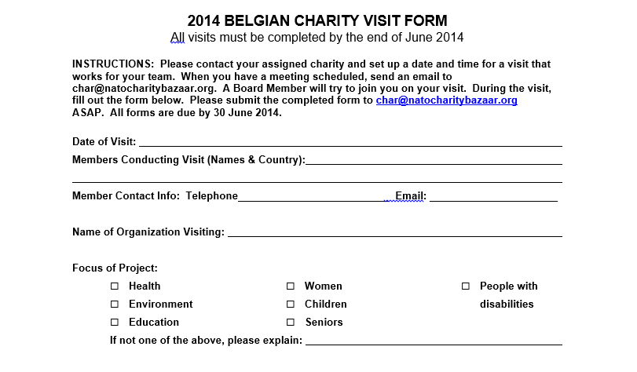
Charity Visits
1/2

Slide 42
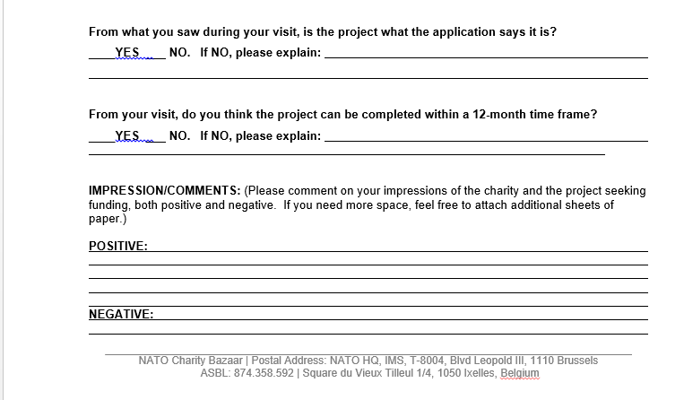
Charity Visits
2/2

Slide 43
Conducting a Charity Visit
Sabrina Janssens, Belgian Charity Coordinator
Fill out the ‘2014 Belgian Charity Visit Form’ during the visit (please find on Members Only area)
After the visit, email the completed form to the Charity Team at char@natocharitybazaar.org
All visits should be completed by 30 June 2014
The completed visit forms will be posted on our website after the voting in September.
Please remember not to talk to anyone other than your visit group and the Board about your Belgian charity visits (secret voting).

Slide 44
Charity Lottery Result
  Project 1: Austria, Montenegro, Poland, Ukraine, Sweden
  Project 2: Hungary, Slovenia, Czech Republic, United Kingdom
  Project 3: Norway, Turkey, Latvia, Albania, France
  Project 4: Belgium, Greece, Spain, Iceland
  Project 5: Finland, Switzerland, Slovakia, Georgia
  Project 6: BiH, Denmark, Former Yugoslavia Republic of Macedonia*, Luxembourg
  Project 7: Azerbaijan, Estonia, Canada, Bulgaria
  Project 8: NIC, Italy, Croatia, Serbia
  Project 9: Germany, Lithuania, Portugal, Tajikistan
  Project 10: USA, The Netherlands, Kazakhstan, Romania
* Turkey recognizes the Republic of Macedonia with it’s constitutional name.

Slide 45
Tombola Update
Carla Bucalossi Quatrini - Tombola Coordinator
  Latest Update
    2 gifts per nation for the Tombola
    Value: at least 100 € each
    Required for participation
    Tombola list will be updated WEEKLY this fall
    Tombola prizes must be delivered to NATO no later than Saturday, November 15

Slide 46
Restaurant Update
Christina Arvanitaki - Restaurant Coordinator
  Latest Update

Slide 47
Closing
Jimmie Bradshaw - President
Any other business
Mrs. Anne-Mette Rasmussen is host at:
Summer Charity Ball on June 21st at 19h30
Tickets are sold out
Please return Voting Cards and blue Folders

Slide 48
Closing
Jimmie Bradshaw - President
June Dates to Remember
5 June – Book Signing
11 June – France’s Champagne Sale
12 June – Bake Sale
17 June – General Assembly Meeting
21 June – Summer Charity Ball
24-26 June – June Photo Exhibit
Please return voting cards and folders

Slide 49
Closing
Jimmie Bradshaw - President
Meeting Dates 2014
17 June
9 & 23 September
07 & 21 October
12 November
Please return voting cards and folders

Slide 50
Just to the Board
Suggestion sent
Board Meeting Dates 2014
June 10
September 2, 16, 30
October 14
November 4
Bazaar 2014 - Sunday 16 November

